Slide 1
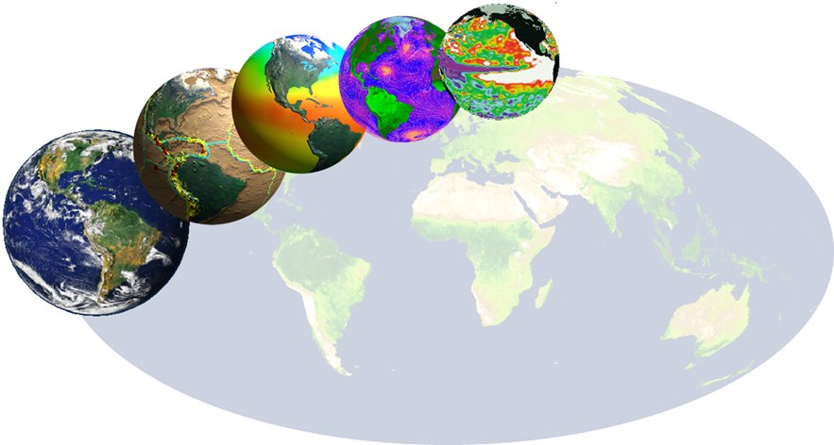
Ecological Applications and Challenges
Maury Estes, Associate Program Manager for Ecological Forecasting
Second Suomi NPP Applications Workshop
November 18-20, 2014

Slide 2
Outline
NASA Ecological Forecasting Program
Current applications in Ecological Forecasting Program
  Feasibility
  Marine and terrestrial projects
New opportunities and key challenges in Ecology for the use of S-NPP data
Ongoing Issues

Slide 3

NASA Applied Sciences Program
Discovering and demonstrating innovative and practical applications of Earth Science.
The Applied Sciences Program supports projects that enable uses of Earth observations in organizations’ policy, business, and management decisions.
http://AppliedSciences.NASA.gov
Key Measure of Project Success: Transition of Products to sustained use by the partner organization(s).
Applications
Develop and transition applications ideas
for sustained uses of Earth observations in decision making.
Capacity Building
Build skills and capabilities in US and developing countries to access Earth observations to benefit society.
Mission Planning
Identify applications early in mission lifecycle and integrate end-user needs in mission design and development.
|‌ 3

Slide 4
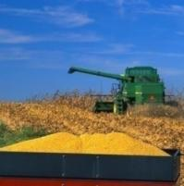
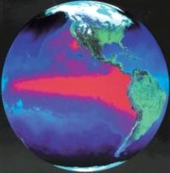
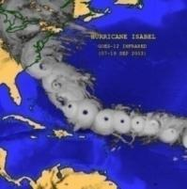
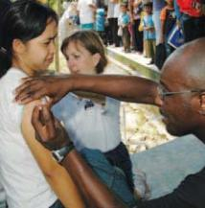
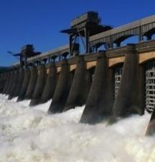


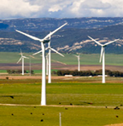

Crosscutting Benefits of Project
Applied Sciences Applications Areas
Emphasis in
4 Applications Areas
Seek opportunities to expand to 5 additional areas
Agriculture
Climate
Weather
Health &
Air Quality
Water Resources
Energy
Oceans
Disasters
Ecological Forecasting
The Ecological Forecasting program is active in international efforts to use satellite obs. in conservation, biodiversity and ecosystem management.
Notes:
Crosscutting nature of project is a strength: eco plus climate weather and oceans. The ecological forecasting program promotes the use of Earth Obs and models to analyze and forecast changes that affect ecosystems and to develop effective resource management strategies. The program is active in international efforts to use satellite obs. In conservation, biodiversity and ecosystem management. While supporting and encouraging innovative new projects in terrestrial, freshwater and marine ecosystems, recently crowdsourcing initiatives have been encouraged to address ecological data gaps.

Slide 5
Range of projects in NASA Ecological Forecasting Program
Fisheries conservation
Sensitive ecosystems
  Coral reefs
  Forest conservation areas
Marine mammal and protected species
Species abundance and movement
Climate change effects
Harmful algal blooms
Wildlife habitats
Others

Slide 6
Recent Feasibility Projects
Rebecca Lewison/San Diego State University
EcoCatch: Improving Ecological and Economic Sustainability of Marine Fisheries Using Remotely-Sensed Oceanographic Data
Clarissa Anderson/University of California, Santa Cruz
Merging Satellite and Numerical Model Data in The California Current to Create Continuous Imagery and Forecasts of Harmful Algal Blooms
Bradley Penta/Naval Research Laboratory
Adaptive Ecosystem Climatology (AEC)
Heather Lynch/Stony Brook University
Bayesian Data-Model Synthesis for Biological Conservation and Management in Antarctica
Kristin Byrd/USGS Western Geographic Science Center
Forecasting Coastal Habitat Distributions through Fusion of Earth Observations, Process Models and Citizen Science: A Climate Change Adaptation Tool for the NOAA National Estuarine Research Reserve System
Notes:
Explain briefly the feasibility to decisions process.

Slide 7
Recent Feasibility Projects (con’t)
Seth Wenger/Trout Unlimited
A System to Forecast the Demographic and Genetic Viability of Salmonid Fish Across Broad Regions Under Changing Climates
Gordon Luikart/University of Montana
Projecting Effects of Climate Change on Pacific Rim Rivers and Salmon: Integrating Remote Sensing, Landscape Genomics, and Demography to Inform Conservation
John Olson/Utah State University
System for Mapping And Predicting Species Of Concern (SMAP-SOC)
Philip Townsend/University of Wisconsin-Madison
Bringing Wildlife Management into Focus: Integrating Camera Traps, Remote Sensing and Citizen Science to Improve Population Modeling
Lilian Pintea/The Jane Goodall Institute
Monitoring and Forecasting Chimpanzee Habitat Health in Africa to Inform Conservation Actions, Strategies and Measure Success
Janneke Hille Ris Lambers/University of Washington
Snow, Montane Wildflowers, and Citizen Scientists
Steve Kelling/Cornell Laboratory of Ornithology
Avian Abundance Estimation Across the Pacific Flyway for Full Life-Cycle Conservation Planning

Slide 8
Marine Projects
Dr. Mitchell Roffer, Roffers Ocean Fishing and Forecasting Service: Management and Conservation of Atlantic Bluefin Tuna (Thunnus thynnus) and Other Highly Migratory Fish in the Gulf of Mexico under IPCC Climate Change Scenarios: A Study Using Regional Climate and Habitat Models
Major End User: Dr. John Lamkin, NOAA SEFSC
Dr. Frank Muller-Karger, University of South Florida: NOAA Coral Reef Watch (CRW): Higher-Resolution Decision Support System for Tropical Coral Reefs
Major End User: Dr. Mark Eakin, NOAA NESDIS

Slide 9
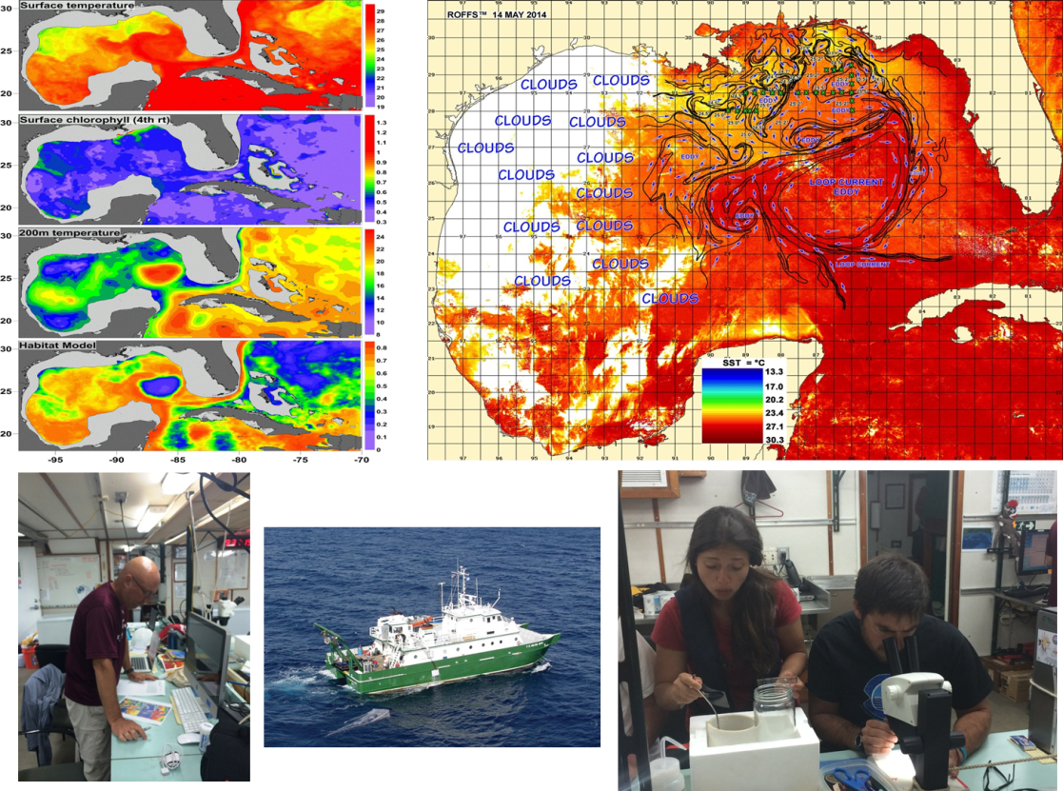
Management and Conservation of Atlantic Bluefin Tuna (Thunnus thynnus) and Other Highly Migratory Fish in the Gulf of Mexico under IPCC Climate Change Scenarios: A Study Using Regional Climate and Habitat Models
This “applications” research project’s goal is to assess the potential changes in habitat extent (adults and larvae) from climate change (IPCC AR4 and IPCC AR5).
Developing habitat models from larvae and adult locations and comparing the present conditions to future forecasted conditions
Satellite infrared and ocean color from NASA (MODIS) along with NOAA (AVHRR) and ESA infrared, as well as, JPSS infrared and ocean color (VIIRS). Satellite altimeters are being used plus real-time and archival data.
Project leverages “Improving The NOAA NMFS and ICCAT Atlantic Bluefin Tuna Fisheries Management Decision Support System and 40 years of research on tuna and billfish conducted by the investigators in the government, academic and private sectors.
Reference: Muhling et al. 2013
Notes:
using climate models which are downscaled from global models to regional models.
ICCAT: International Commission for the Conservation of Atlantic Tuna
JPSS: Joint Polar Satellite System
Roffers image: composite of temperature, currents, eddy features developed in realtime with data from USF satellite receiver: Very useful to guide/inform NOAA sampling cruises collecting data to validate models and assess spawning.

Slide 10
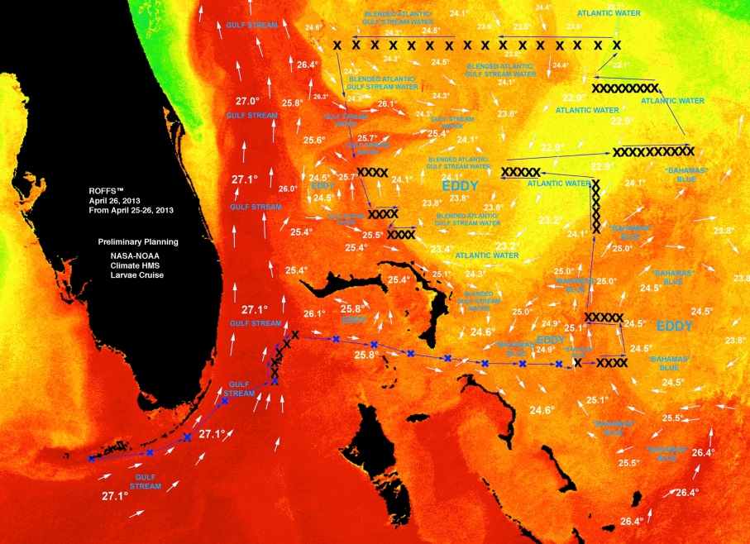
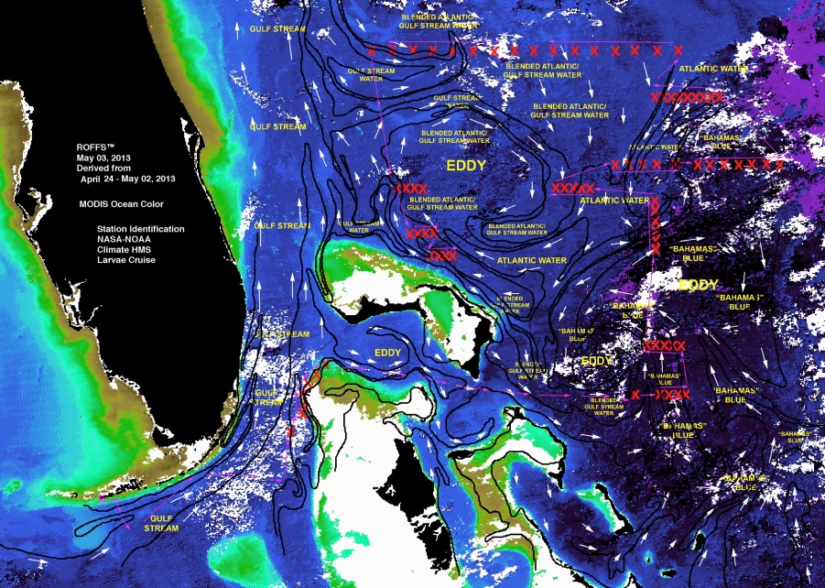
NASA Applied Sciences Project Finds New Spawning Sites for Atlantic Bluefin Tuna
Mitchell A. Roffer, PI, West Melbourne Florida
Highlight: Bluefin tuna larvae were found in the Bahamas—outside the Gulf of Mexico, the traditional spawning area for this population. This has significant international management consequences as NOAA stock assessments have assumed only Gulf of Mexico spawning.
How: Thanks to an Applied Sciences project with PI Roffer, NASA infrared and ocean color satellite data are now routinely used by the NOAA National Marine Fisheries Service for stock assessment and management, in this case to identify areas to survey for Atlantic bluefin tuna (Thunnus thynnus) and other fish larvae.
Insert Image(s) here
Relevance: NOAA uses remote sensing-driven habitat models from this project team to evaluate the effects of changing climate on the reproduction and distribution of several economically and ecologically important migratory tuna and billfish species. NOAA directly benefits from increased operational efficiency (ship time is approximately $20K per day) in using satellite imagery and models to focus its ship-based larval surveys. Resulting larval counts feed stock assessments that set limits on the number of fish taken.
Figure 1 Infrared (top) ocean color (bottom) satellite derived oceanographic analysis showing the stations (X) where the NOAA research vessel will sample based on the conditions.
Notes:
Technical Description of the Images: Top image is an color enhanced infrared composite (NASA, NOAA and ESA satellites) over a 24 hour period (April 25-26, 2013) of Florida and the northern Bahamas. White arrows indicate the current direction (not speed). Sea surface temperature (C°), eddy features and water color are labeled. Blue arrows indicate the initial direction of the cruise and blue “X” indicate initial stations. Black “X” indicate probable stations for sampling net tows for fish larvae based on the ocean conditions which are likely to change as a function of real-time satellite data. Black arrows indicate the likely course of the research vessel. The bottom image is a nine day MODIS Aqua composite (April 24-May 02, 2013). White arrows indicate the current direction (not speed). Water mass boundaries are outlined in black. Red “X” are the proposed station locations that are subject to change as a function of the ocean conditions and the results of the sampling nets for fish larvae. Red arrows indicate the proposed track of the research ship.
These data and habitat models pointed to an area not previously sampled (i.e., unknown waters).

Slide 11
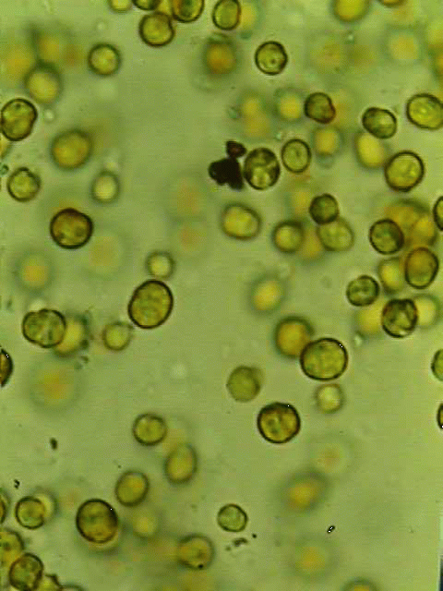
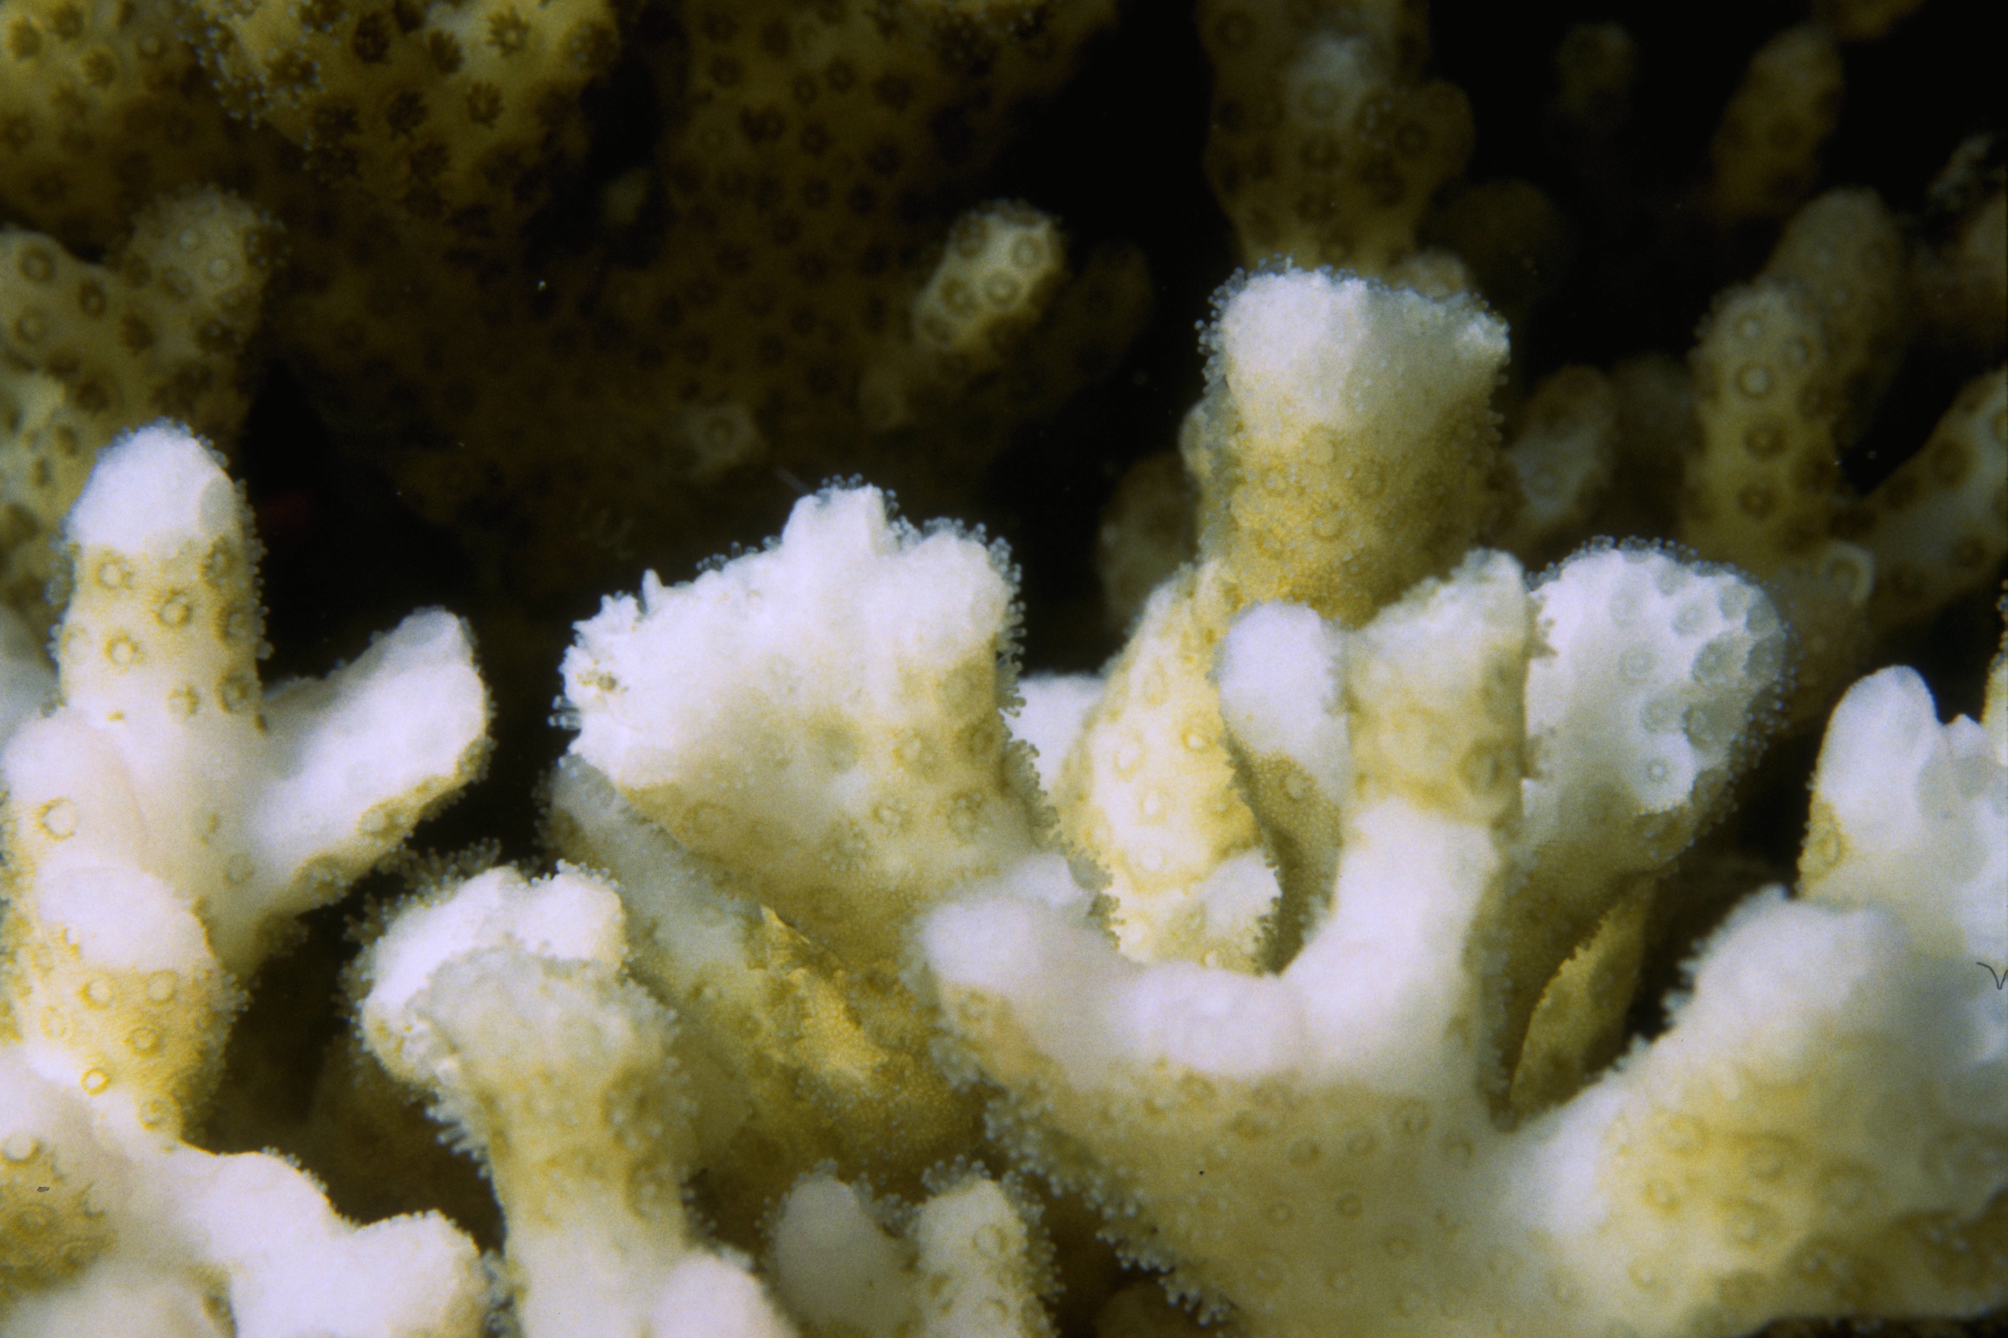
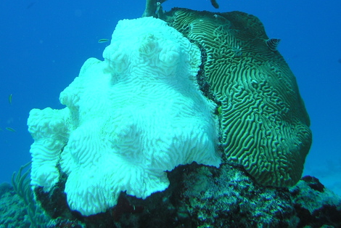
Coral Bleaching:
Impact of Climate Change
Most of corals’ food comes from photosynthesis
Scott R. Santos
Corals exposed to high temperatures and/or high light become stressed
Corals eject their algae; coral appears “bleached
If stress is mild or brief, corals recover, otherwise they die
zooxanthellae
Symbiotic algae
Mass bleaching covers 100-1000’s km2
Notes:
The problem: Coral reef bleaching is increasing in frequency and severity as the ocean warms. Coral bleaching results when prolonged high temperatures result is levels of stress that cause corals to eject the microscopic algae living in their tissues. If these thermal stress events are especially severe or long-lasting, corals will die. Even if they recover, thermal stress increases corals’ susceptibility to disease. Loss of corals destroys the most diverse ecosystem on earth, threatening fisheries, tourism, and coastal protection that reefs provide.
Relevance: Surveys of coral reef managers around the world overwhelmingly showed that users required higher spatial resolution in products. Existing 50km spatial resolutions are not fine enough to make wise management decisions. Some actions in response to bleaching include closing areas to use and experimental cooling/shading of coral reefs. On a longer term, better data aid reef managers in planning for different uses such as protecting most resilient reef to save them for the future.

Slide 12
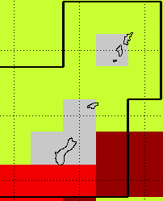
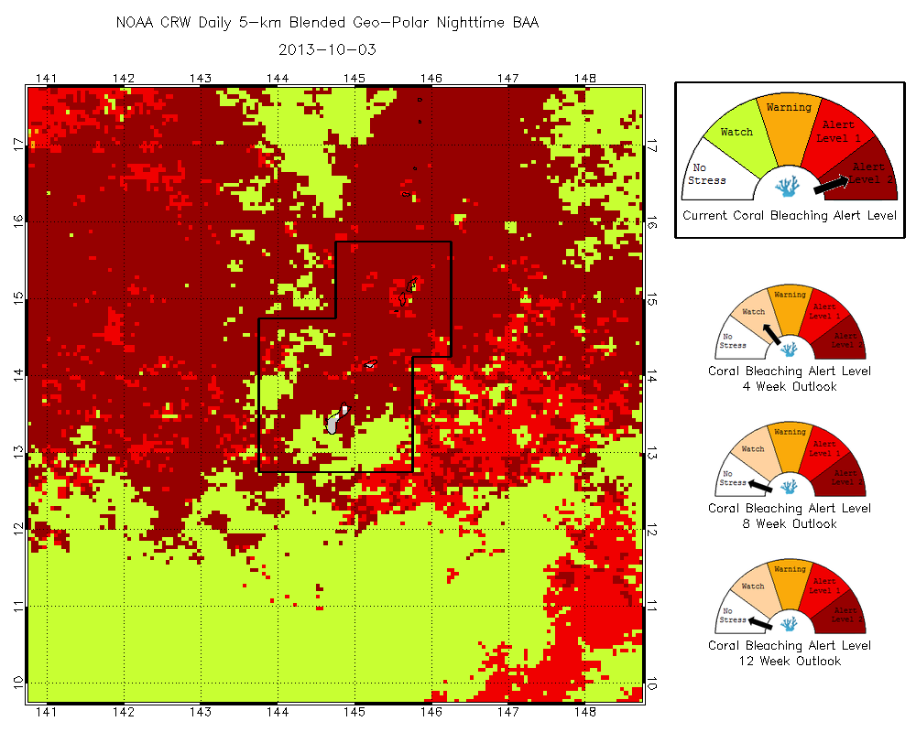
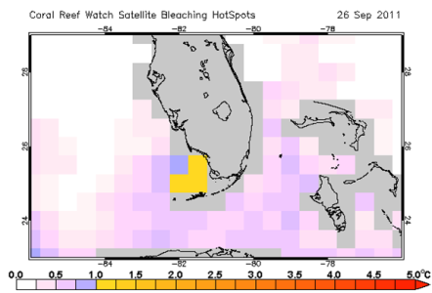
NOAA Coral Reef Watch (CRW): Higher-Resolution Decision Support System for Tropical Coral Reefs
Frank Muller-Karger, University of South Florida / Mark Eakin, NOAA NESDIS
1A
Next-generation, near-real-time global coral bleaching alert products now available
Global products with 100x finer spatial resolution than NOAA operational products (50x50km)
5x5km global products use a blend of geostationary and polar orbiters from multiple countries
5km products becoming operational at NOAA Coral Reef Watch
1x1km regional products using MODIS Sea Surface Temperature
1km products for Gulf of Mexico/Caribbean Sea are served by CONABIO in Mexico in a bi-national collaboration
1a
1b
Figure 1. CRW 5-km “Bleaching Alert Area” showing value of 5km data during Oct. 2013 bleaching in Guam and Marianas Islands
50 km HotSpot
1c
Figure 2. User newsletter already using new CRW products.
http://coralreefwatch.noaa.gov/satellite/bleaching5km/index.php
Notes:
Project Summary: Next-generation, near-real-time global coral bleaching alert products are now available to the public as of April 2014. The new products have up to 100x greater spatial resolution than the operational NOAA Coral Reef Watch products. Global products using a blended analysis of geostationary and polar orbiters from multiple countries now have spatial resolution of 5x5 km² pixels (as opposed to 50x50 km²). Regional products now have 1 km² resolution using MODIS Sea Surface Temperature data. The 5 km products are moving toward operational status at NOAA/NESDIS. Regional, 1-km products for the Gulf of Mexico/Caribbean Sea are served by CONABIO in Mexico in a bi-national collaboration .

Slide 13
Terrestrial Projects
Dr. Patricia Heglund, U.S. Fish and Wildlife Service, Effects of extreme climate events on avian demographics
Major End User: USFWS
Dr. Andrew Hansen, Montana State University, Using NASA resources to inform climate and land use adaptation: Ecological forecasting, vulnerability assessment, and evaluation of management options across two US DOI Landscape Conservation Cooperatives
Major End User: National Parks Service
Dr. Gil Bohrer,The Ohio State University, Animal Movement: Discovering relationships between climate and animal migration with new tools for linking movement tracks, weather, and land surface data
Major End User: USFWS, National Park Service, USGS, USFS

Slide 14
CLIMATE AND BIOLOGICAL RESPONSE
Effects of extreme climate events on avian demographics
PI Patricia Heglund, US Fish and Wildlife Service
The primary objectives of this project are to:
  Predict the effects of extreme climate and weather events on bird demographics
  Quantify the role of National Wildlife Refuges and National Forests as refugia for waterfowl and forest birds respectively during extreme events, and to identify management actions to enhance this function
Earth observations applied: MODIS, SRTM, AVHRR, AMSR-E, Landsat
|‌ 14
Notes:
NPP – National Polar-orbiting Partnership (launched 10/28/2011) – formerly National Polar-orbiting Operational Environmental Satellite System (NPOESS)
Verner Suomi (U. Wisconsin)
VIIRS – Visible Infrared Imaging Radiometer Suite

Slide 15
CLIMATE AND BIOLOGICAL RESPONSE: NDLAS (National Data Land Assimilation System)
Potentially use “combined” to represent the total effect of heat and drought on birds, and biodiversity generally.
Notes:
We used temperature, precipitation, and potential evapotranspiration data provided by NDLAS (National Data Land Assimilation System), a NASA sponsored effort modeling vegetation, land surface, and atmospheric conditions at 12 km resolution, to build base data sets of SPI (Standardized Precipitation Index), SPEI (Standardized Precipitation and Evapotranspiration Index), and an index newly developed in our project, ‘STI’ (Standardized Temperature Index). The NLDAS data were validated against observational data and found to be accurate enough to provide good individual index estimates. We are currently working to combine these into a single index (see for example the lower map, labeled ‘combined’ , as a way to represent the total effect of heat and drought on birds, and biodiversity generally. Additionally, the potential evapotranspiration variable in NLDAS will be used to compare and evaluate simpler methods of obtaining potential evapotranspiration, which will be needed in our scenario studies."

Slide 16
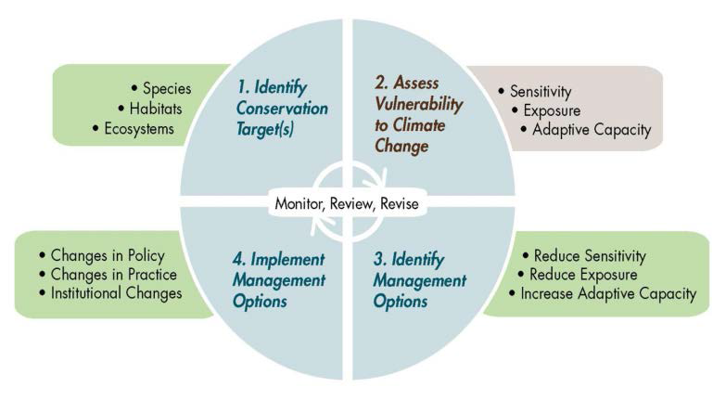
Using NASA resources to inform climate and land use adaptation: Ecological forecasting, vulnerability assessment, and evaluation of management options across two US DOI Landscape Conservation Cooperatives operatives
PI: Andrew J. Hansen, Montana State University
1. Quantify trends in ecological processes and ecological system types from past to present and under projected future climate and land use scenarios.
2. Assess the vulnerability of ecological processes and ecological system types to climate and land use change by quantifying exposure, sensitivity, adaptive capacity, and uncertainty in and around focal national parks within LCCs.
3. Evaluate management options for the more vulnerable ecosystem processes and types within these focal parks.
4. Design multi-scale management approaches for vulnerable elements to illustrate adaptation strategies under climate and land use change.
Notes:
For snowpack, soil moisture, watershed outflow and primary productivity for our study areas. We found that each of these four ecosystem processes were projected to decline substantially in the Rockies in the coming century
Approach is using NASA and other data and models across two LCCs.
NASA Terrestrial Observation and Prediction System (Tops). The Terrestrial Observation and Prediction System (TOPS) [http://ecocast.arc.nasa.gov] is a flexible modeling system that integrates ecosystem models with satellite and surface weather observations to produce ecosystem nowcasts and forecasts useful in natural resources management, public health, and disaster management.

Slide 17
Vegetation Response
In the Great Northern LCC, results from three published studies of tree species indicated substantial declines of area of climate suitability for the four subalpine species by 2100. This was especially true for Whitebark pine (Fig. 6).
Suitable climate for Whitebark pine dropped from just over 20% in the reference period
The modeling of biome types indicated largely a shift from alpine and subalpine conifer to desert scrub and grassland types and indicated highest vulnerability for Whitebark pine and Mountain hemlock.
Fig. 6. Bioclimate projections for Whitebark pine for 2010 to 2099 under 30-year moving
Notes:
The results should be helpful to federal managers who are now prioritizing species and community types for climate adaptation strategies.

Slide 18
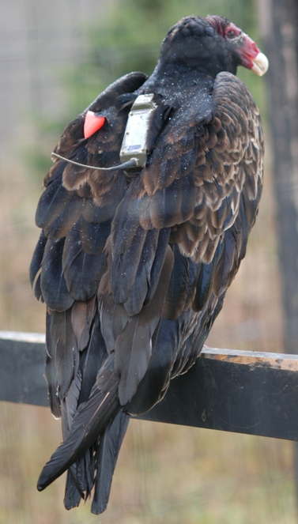
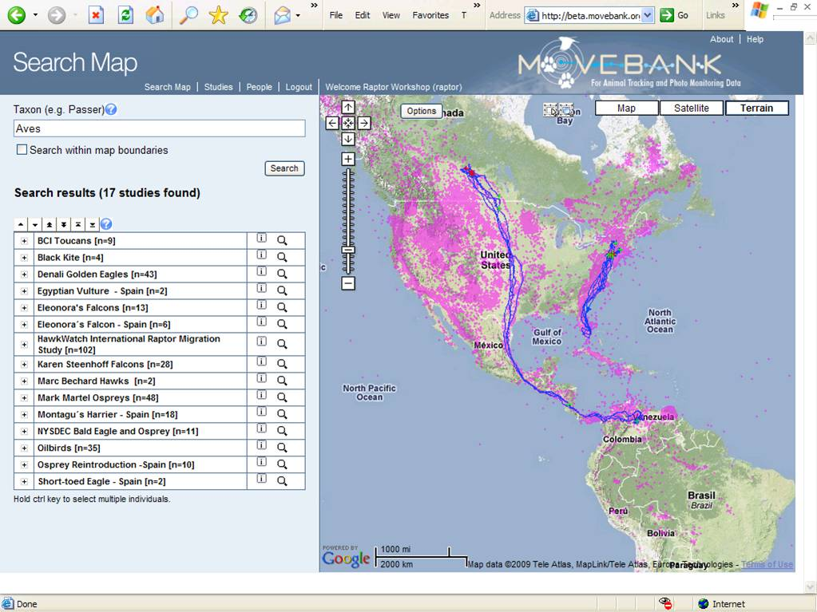
Movebank: Env-DATA Tools
Dr. Gil Bohrer, Ohio State University
Goal: Develop annotation and analysis tools in the online database www.movebank.org The new Env-DATA system enhances Movebank, an open portal of animal tracking data, by automating access to environmental variables from global remote sensing, weather, and ecosystem products from open web resources.
Movebank is an online data repository for animal movement data that provides data, tools, and services to help users analyze and visualize animal movement data and its relationship to environmental and other factors. (185 species, over 19,000 tracks and 51 million data points)
Why: To facilitate study of weather and land-surface effects on animal movement and migration tracks
Approach: Connect NASA and other sources of environmental data to the existing Movebank tools, and develop new tools
Key end users: DOI and other agencies; all Movebank users
Notes:
Movebank is an online data repository for animal movement data that provides data, tools, and services to help users analyze and visualize animal movement data and its relationship to environmental and other factors.
Affecting U.S. Federal partners through an international platform on animal movement; allows for wider reach of the NASA inputs
Participants from DOI agencies (National Park Service; Fish and Wildlife Service; USGS) and USDA Forest Service
As of January 2012, Movebank holds 429 studies of animal movement data published by 159 contributors. These studies include tracking worldwide data of 185 species, 19,414 tracks, which so far contains about 51,000,000 data points that expands by the day.
The new EAGLES system in the use of Earth obs for habitat mgmt and species consv. (Ecosystem Assessment, Geospatial analysis and Landscape Evaluation System)

Slide 19
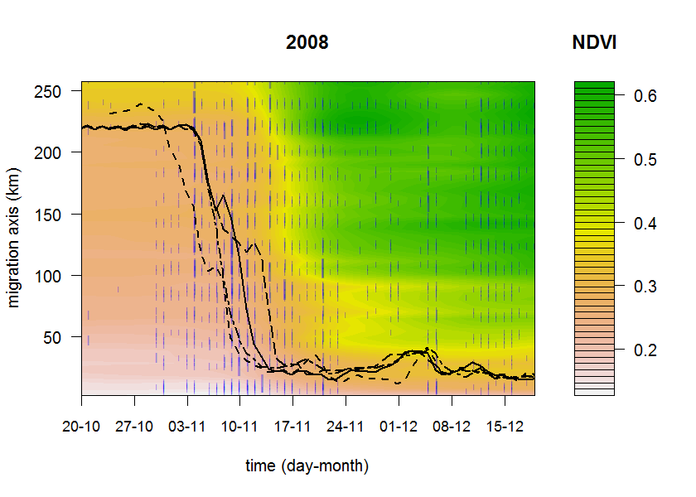
Example: Zebra migration in the Okavango Delta
Technical Results
Zebra Migration
Tracks along the migration axis(dashed line left bottom) annotated with NDVI (color) and TRMM precipitation (blue streaks). A model we developed can predict zebra movement with r²>0.9
Notes:
Zebra migrate from the delta (where they can live year round) to the salt pans (which only have grass after the flood). The zebra must time their departure to be in the pans in the short time after the flood, when the grass has started growing and is extra lush. They leave the delta after a certain precipitation threshold has occurred. They travel faster if NDVI in the delta is high and slower (sometimes even return for a while) when it is raining.

Slide 20
Opportunities with S-NPP
VIIRs day/night band
  Nighttime visible offers a new capability with potential innovative research applications
Potential for continuation of MODIS data for ongoing projects

Slide 21
Challenges and Opportunities in Ecology (Rose et al. 2014, Turner 2014)
Species distributions and abundances
  Primary productivity, sea surface height, land cover are associated with ecological response variables ranging from extinction probability to genotype (Pettorelli et al. 2014)
  Spatial resolutions may be coarser than scales taxa interact with the environment
Species movements and life stages (migration and movement within and across habitats)
  What are the environmental cue that initiate animal migration and movement?
  Tracking animal movements with VIIRs day/night band?
Ecosystem processes
  Response to disturbances (e.g. coastal erosion from hurricanes/tsunami, fire, etc.)
Climate change
  Can affect ecosystem state and function
  need long-term multi-scale observations to understand relations between climate change, ecosystems, and species that are a high priority for conservation
  Lack of in situ time series data for ecosystem components (crowdsourcing!)
Protected areas
  Geopolitical versus ecological boundaries ….. Need to conserve ecosystem function and species

Slide 22
Challenges and Opportunities in Ecology (con’t)
Rapid Response
  Fire Information Resource Management System
  Coral Reef Bleaching Alert System http://coralreefwatch.noaa.gov/satellite/index.php)
  Fishery piracy (VIIRs day/night band)
  Ocean search and rescue operations (VIIRs day/night band)
Ecosystem services
  Intersection of ecology and economics (e.g; Florida beaches, ecotourism etc.)
  Improved tools to document and monitor the results of current and future policy scenarios
Conservation effectiveness
  Monitoring of conservation efforts and policy
Agricultural and aquacultural expansion and changes in land use land cover
  Expansion of extent to meet food needs versus changes in ecosystems and services (e.g.; carbon storage, soil nutrients, etc.).
  Need agricultural rates of expansion and intensification at multiple scales.
  Aquaculture risks introduction of an invasive species (e.g.; oyster drill)
Degradation and disturbance regimes
  Land cover changes detectable may miss important changes (e.g., species composition and vegetative structure)
  Need more hyperspectral and in situ data to effective evaluate in some areas.

Slide 23
Ongoing Issues
Can VIIRs really replace MODIS?
  Critical for sustained applications currently using MODIS
  Continuation of monitoring datasets
Ocean Color
  Green bias and excessive banding have been an issue for ocean color products (recent ocean biology progress made)
  NASA (public) and NOAA (public) : consistent algorithm for ocean color products is desired
More banding and distortion on edges or at high angles (VIIRs designed for ground pixel size not to change (constant pixel size)
S-NPP “near real-time data” limits utility for some applications (4-6 hour delay for data, longer for MODIS compatible)
  Limited use for ocean search & rescue, guidance for sampling cruises
Could some products for special purposes be provided to end users faster (within one hour of retrieval?)?
  Cost for receiving system 250k, plus staff to manage system and maintenance
Notes:
Is there a viable strategy for supporting near real-time VIIRS data products that are consistent with the MODIS data products that are currently in use by a large percentage of ASP-supported projects?

Slide 24
References
Rose et al. 2014. Ten Ways Remote Sensing Can Contribute to Conservation. Essay, Conservation Biology, Volume 00, No. 0, 1-10
Turner, W. 2014. Sensing biodiversity: Sophisticated networks are required to make the best use of biodiversity data from satellites and in situ sensors. Science, Vol 346, Issue 6207
Dodge, S., Bohrer, G., Weinzierl, R. Davidson, S. C., Kays, R., Douglas, D., Cruz, S. Han, J., Brandes, D. and Wikelski, M. 2013. The environmental-data automated track annotation (Env-DATA) system: linking animal tracks with environmental data. Movement Ecology, 1:3
Muhling, B.A., P. Reglero, L. Ciannelli, D. Alvarez-Berastegui, F. Alemany, J.T. Lamkin, and M. A. Roffer. 2013. A comparison between environmental characteristics of larval bluefin tuna (Thunnus thynnus) habitat in the Gulf of Mexico and western Mediterranean Sea. Marine Prog. Ser. 486:257-276.
Acknowledgements
Woody Turner for editorial comments and presentation suggestions
Jay Skiles and Gary Geller for Terrestrial Ecology project slides

Slide 25
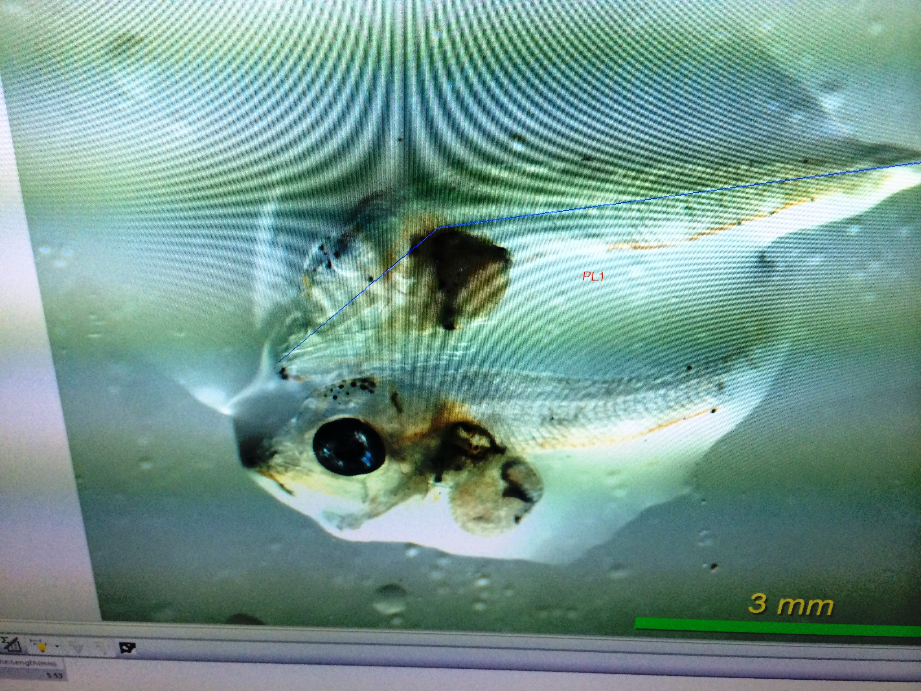
Thanks!
Questions?
maury.estes@nsstc.uah.edu

